Slide 1
Network : Internet Protocol (1)
Jae Hyeon Kim

Slide 2
Reference
William Stalling, Data and Computer Communications 10/E, Prentice Hall

Slide 3
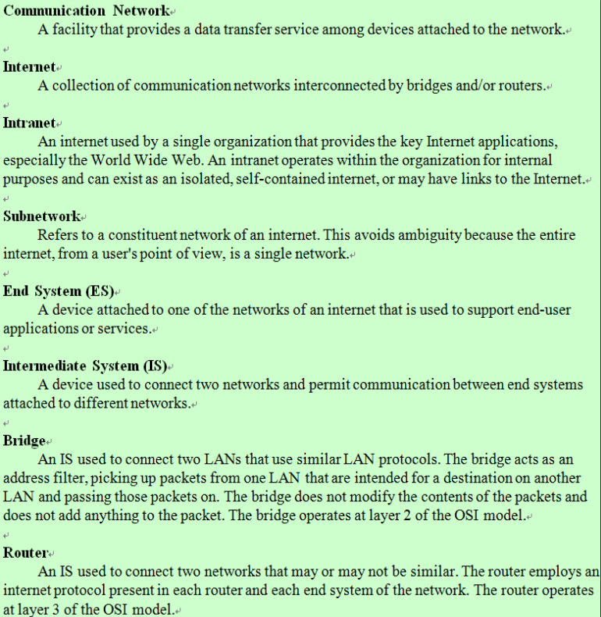
Internet Protocol

Slide 4
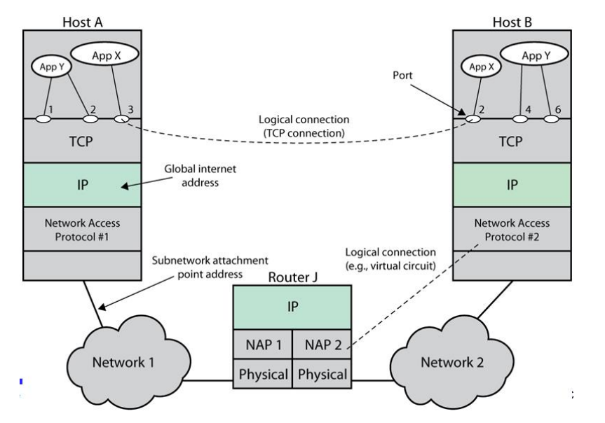
TCP/IP Concepts

Slide 5
Connectionless Operation
Internetworking involves connectionless operation at the level of the Internet Protocol
IP provides a connectionless service
Initially developed for the DARPA Internet project
Protocol is needed to access a particular network
Connectionless Internet facility
Is flexible
Can be made robust
Does not impose unnecessary overhead

Slide 6
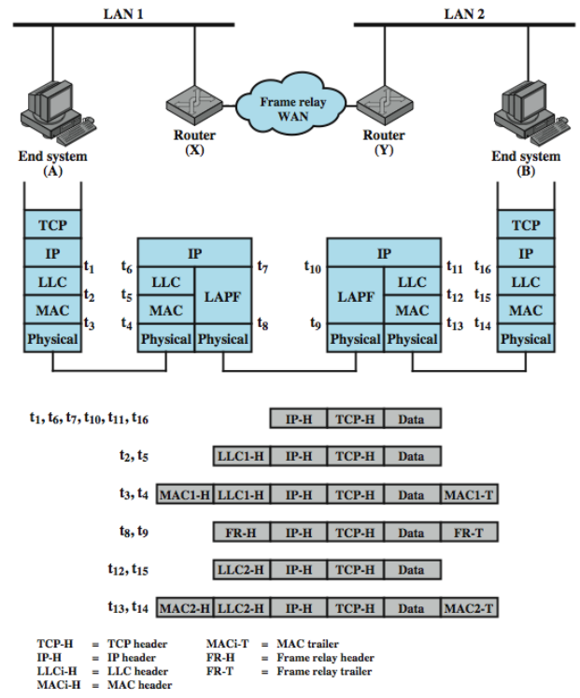
IP Operation

Slide 7
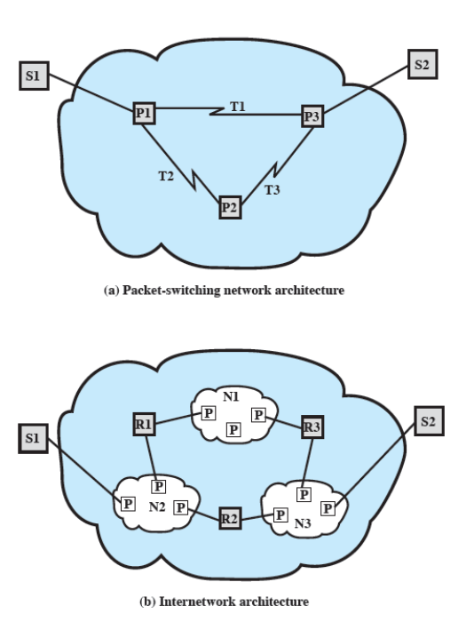
IP Design Issues
Routing
Datagram lifetime
Fragmentation and reassembly
Error control
Flow control

Slide 8
Routing
ES/router maintain routing tables
The table indicate next to which datagram is sent
It can be static or dynamic
Router decides the next router to which the internet datagram should be sent : see next in detail
Source routing : source specifies route to be followed and can be useful for security and priority
Route recording : each router appends its Internet address to a list of addresses in the datagram, useful for testing and debugging

Slide 9
Datagram Lifetime
Datagrams could loop indefinitely, possibly with making use of incorrect routing information
Consumes resources
IP may need upper bound on lifetime of a datagram
IP lifetime
Specified in lifetime, so Time to Live (8 bits), TTL in IP header
Initially, it is assigned in the sender’s OS, as 64 or 128
Every router that processes a datagram must decreases the TTL by at least one, so the TTL is similar to a hop count
In addition, the router decrease the time, in seconds, that a datagram is stayed in the router

Slide 10
Fragmentation and Re-assembly (1)
Lower-level protocols may need to break data up into smaller blocks, called fragmentation
Reasons for fragmentation
Network only accepts blocks of a certain size
More efficient error control & smaller retransmission units
Fairer access to shared facilities
Smaller buffers
Disadvantages
Greater overhead with more percentage of control information
More interrupts & processing time

Slide 11
Fragmentation and Re-assembly (2)
Issue of when to re-assemble
At destination : packet get smaller ad data traverses Internet
At intermediate node (router) : need large buffers at routers, buffer may fill with fragments, all fragments must go through same router

Slide 12
IP Fragmentation
IP re-assembles at destination only
Make use of fields in header
Data unit identifier (ID) : identifies end system originated datagram
Data length : length of user data in octets
Offset : position of fragment of user data in original datagram
More flag : indicates that this is not the last fragment

Slide 13
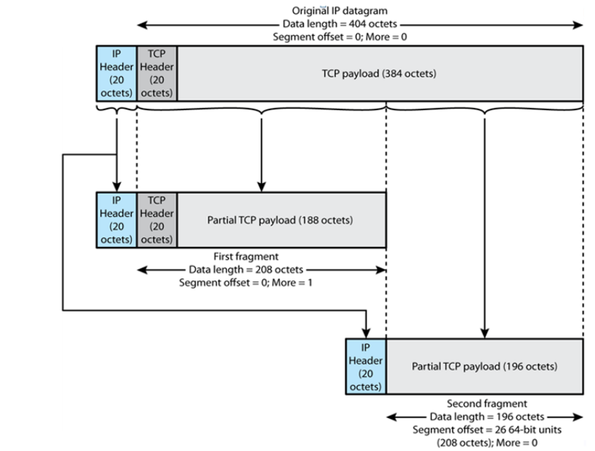
Fragmentation Example

Slide 14
Error and Flow Control
Error control
Discarded datagram
So, identification is needed
Reasons for discarded datagrams include : lifetime expiration, congestion, FCS error
Flow control
Allows routers to limit the rate they receive data
Send flow control packets requesting reduced data flow
Error and flow control takes place in station to station
That is, TCP have the role

Slide 15
Internet Protocol (IP) v4
IPv4 is defined in RFC 791 as a part of TCP/IP suite
It consists of two parts
Specification of interface with a higher layer
Specification of actual protocol format and mechanisms
IP services
Primitives : specifies functions to be performed, the actual form of a primitive is implementation dependent
Parameters : used to pass data and control information

Slide 16
IP Parameters
Source address and destination address
Protocol
Type of Service
Identification
Fragment indicator {More bit | Don’t fragment bit}
Time to live
Data length
Option data (security, source routing, route recording, stream identification..)
User data

Slide 17
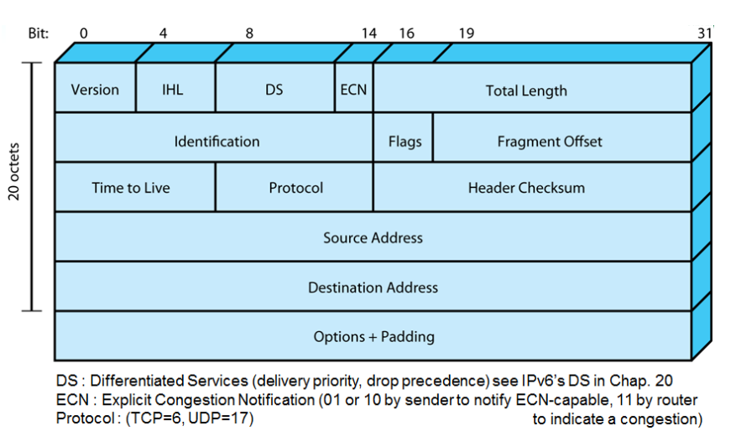
IPv4 Header

Slide 18
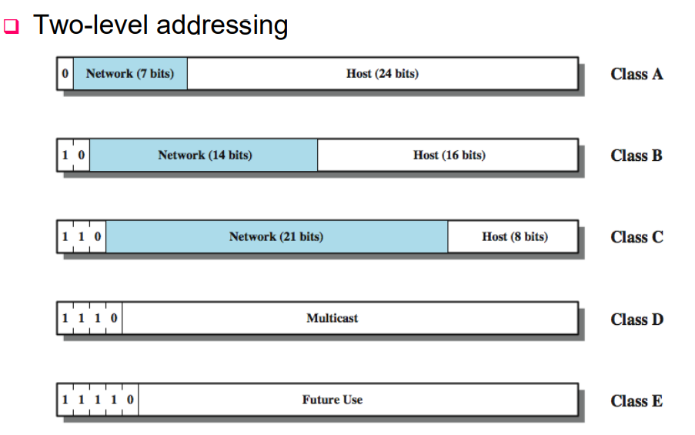
IPv4 Address Formats

Slide 19
IP Addresses
Class A
Start with binary 0, range 1.x.x.x to 126.x.x.x
All 0 reserved, 01111111 (127) reserved for loopback
Class B
Start with binary 10, range 128.x.x.x to 191.x.x.x
Class C
Start with binary 110, range 192.x.x.x to 223.x.x.x
Private address (vs. public address)
Range as 10.x.x.x, 172.16.x.x, 192.168.x.x
Mapped by a Network Address Translation (NAT) box

